Slide 1
Data Analyst Nanodegree
Session 3
Conducted by: Hamza
Notes:
https://udacity.zoom.us/j/7991233356

Slide 2
Slack / SUPPORT / REPOs
https://join.slack.com/t/egypt-fwd-june/shared_invite/zt-qmsc20kz-V1sl~e7wbK7WUt3B2dJhtQ
fwd-support@udacity.com
https://github.com/santarabantoosoo/Data-Analysis-NanoDegree

Slide 3
Agenda
Teaser
Probability
Binomial distribution
Conditional probability
Bayes rule (in depth)

Slide 4

Conduct a study!

Slide 5
What u think?
“A statewide antibody study estimates that 21% of New York City residents have had the coronavirus, Cuomo says.”

Slide 6
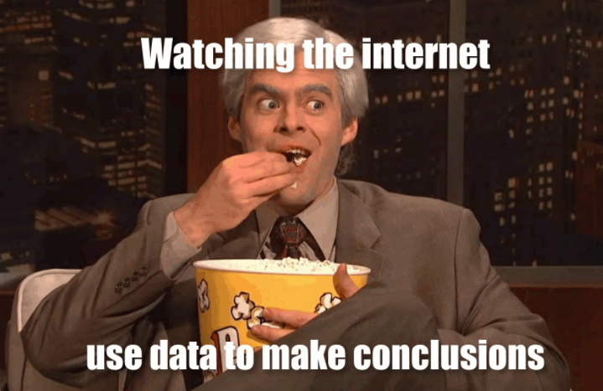
Trust ☺
Notes:
Ya3ny eh?
If lopsided results are misleading, that doesn’t necessarily mean that they were born out of the intent to mislead. Perhaps they were, perhaps they weren’t. Statistical bias can come about through negligence, ignorance, expediancy, or shenanigans.

Slide 7

What is bias?
What’s variance?

Slide 8
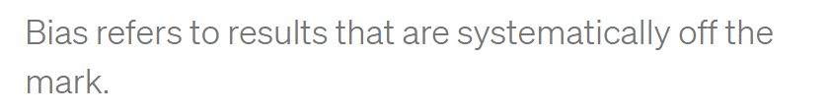
Notes:
High bias doesn’t mean you’re shooting all over the place (that’s high variance), but may cause a perfect archer hit below the bullseye all the time.

Slide 9
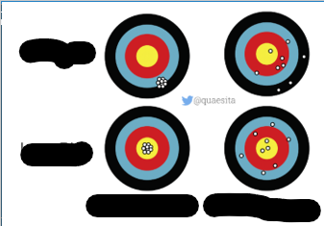

Slide 10
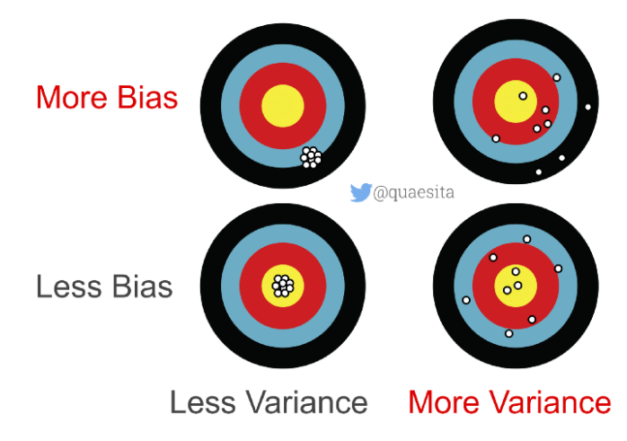

Slide 11
Bias/variance? Over or under?
“A statewide antibody study estimates that 21% of New York City residents have had the coronavirus, Cuomo says.”
What u think?
Notes:
Over or under estimation?
Over estimation
The true is low
Why? I smell the pungent odor of randomization issues with how the data were obtained, which brings me to statistical subdefinition #2.

Slide 12
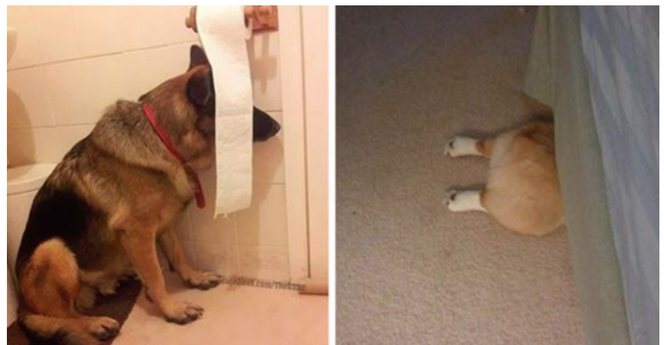
Indoor?
Notes:
What clever thing did they do to collect data from people who stay indoors?
As it turns out, no clever thing.

Slide 13
Questions to ask?
What’s the probability the study measured someone who is fully self-quarantined?
How many NYC residents are keeping themselves entirely to themselves?
Notes:
Zero.
We don’t know.

Slide 14
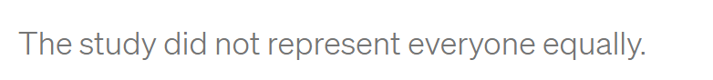
conclusion
Notes:
Selection bias
A special way to trigger results that are systematically off the mark is to collect your data in a problematic manner. For statisticians who love having things to be grumpy about, selection bias is a cherished frenemy. It visits so often!
Selection bias occurs when different members of your population of interest have different probabilities of arriving in your sample.
In other words, you’re making conclusions from your sample as if it were drawn randomly while it was drawn, er, “randomly” instead.

Slide 15

Notes:
In that case, your sample isn’t representative of your population… which makes your conclusions untrustworthy.
If your population of interest is all New York City residents, then you don’t have a random sample (SRS) unless every single New York City resident has equal probability of being included. Is that requirement met by the NY antibody study? Definitely not.

Slide 16
Undercoverage bias
How to solve?

Slide 17
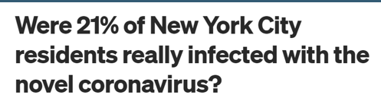
Solution
“all NYC residents who go outside”
Notes:
One pragmatic quick fix for undercoverage bias is to settle for a less ambitious population definition. Instead of trying to make inferences about “all NYC residents” you could choose instead to talk about “all NYC residents who go outside” — problem solved!

Slide 18
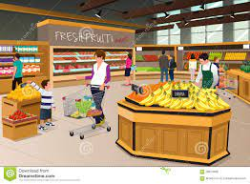
Now fixed?
The study tested people “at
grocery and big-box stores.”
Any problem?
Notes:
Let’s see how the data were gathered. The study tested people “at grocery and big-box stores.” If you’d like increase your probability of exposure, where do you go? To places with a higher density of people, like grocery and big-box stores. Where was the study done? Yup.

Slide 19
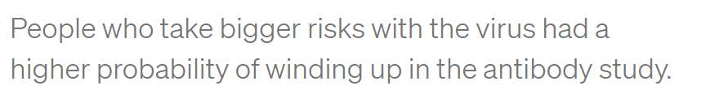
Grocery frequent visits
Notes:
How about if you really, really, really want to get the virus? You might go to grocery and big-box stores frequently… more frequently than someone who’s trying to reduce their probability of infection. Of these two kinds of people, which kind of person would be more likely to have COVID-19 antibodies? Which do you think would be more likely to be in the right place at the right time to participate in the study? Hello, selection bias!

Slide 20

volunteer bias ?
Notes:
volunteer bias because he suspects he was infected, or currently infected

Slide 21
How to solve?
Notes:
Biased archers have it easy — if you keep hitting the target above the center, at least you can see it and make adjustments. Researchers with selection bias aren’t so lucky. Selection bias means all your results are wrong and you don’t know how wrong.

Slide 22
No Solution ☹
Why?

Slide 23
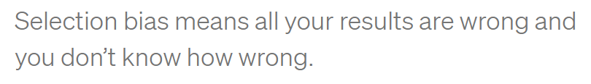
No Solution ☹

Slide 24

Notes:
Is this enough?

Slide 25
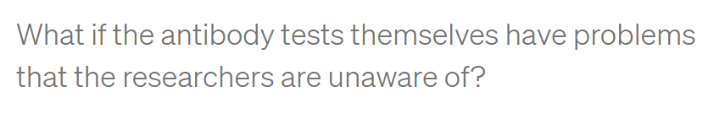
Biased conclusions
PCR sensitivity
threshold
Notes:
information bias occurs when measurements are systematically incorrect.
Have u heard of PCR sensitivity?
What if they only detect antibodies above a strict threshold to avoid false alarms?

Slide 26
Information vs selection
خالصين ؟

Slide 27
Conclusion about population?
What do we know about NYC residents’ actual exposure rate?
Notes:
Exposure rate : we know Nothing

Slide 28
Conclusion about population?
What do we know about NYC residents’ actual exposure rate?
- What do we know for sure?
Notes:
What we know for sure?
Some people at grocery and big box stores got an exciting readout from something called an antibody test.

Slide 29
Business Insider
“preliminary”
sampling issues
So where is the problem?
Notes:
To be fair to Business Insider, I think they did a pretty good job of reporting. They even called the results “preliminary” and mentioned some of the same sampling issues I talked about. Kudos! These are the same properly-cautious noises originally made by the governor of NY and the team who ran the study. I have no beef with them either. Instead, my complaint is with the broken telephone game that the rest of the internet is playing.

Slide 30
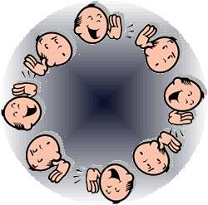

What is the problem?
Soret el telephone el 5arban
Notes:
Instead, my complaint is with the broken telephone game that the rest of the internet is playing.

Slide 31

Most common
1- Read all article?
2- say I haven’t read
3- report the title only?
Notes:
What most frequently occurs on whatsapp?
Report the title only.

Slide 32
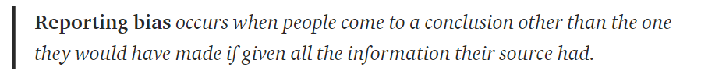
Reporting bias

Slide 33
When reporting bias happens?
Journal club?
Twitter?
Trick
Feel better
Advertising a scientific article
Notes:
Make pithy summaries of complicated things (e.g. to squeeze everything into a 280 character tweet).
Prevent readers’ eyes from glazing over (e.g. journalists editorializing scientific publications).
Persuade someone through trickery (e.g. conveniently “forgetting” to mention studies that cast doubt on the arguments you’re hoping to make).
Feel better about their opinions (e.g. when they’re suffering from confirmation bias).

Slide 34
Is the study worthless?
Notes:
Does this mean that the study is worthless? No, but it’s only as good as the assumptions you’ll make about it. Since there’s very little that we know for sure from its data, the only way to make inferences beyond the facts is to bridge the gap with assumptions. That’s all statistics is. Assumptions, not magic.
Unfortunately, we’re not all equally qualified to make good assumptions that lead to useful conclusions. For example, while I am a statistician with plenty of real-world data collection experience, I’m not an expert in antibody tests, so you shouldn’t trust me to make wise assumptions about their accuracy. Excellent! I don’t trust me either, so I’ll end up learning nothing about the virus exposure rate of NYC. The study is worthless in my hands.

Slide 35

Is the study worthless?
As good as the assumptions
Notes:
Does this mean that the study is worthless? No, but it’s only as good as the assumptions you’ll make about it. Since there’s very little that we know for sure from its data, the only way to make inferences beyond the facts is to bridge the gap with assumptions. That’s all statistics is. Assumptions, not magic.
Unfortunately, we’re not all equally qualified to make good assumptions that lead to useful conclusions. For example, while I am a statistician with plenty of real-world data collection experience, I’m not an expert in antibody tests, so you shouldn’t trust me to make wise assumptions about their accuracy. Excellent! I don’t trust me either, so I’ll end up learning nothing about the virus exposure rate of NYC. The study is worthless in my hands.

Slide 36
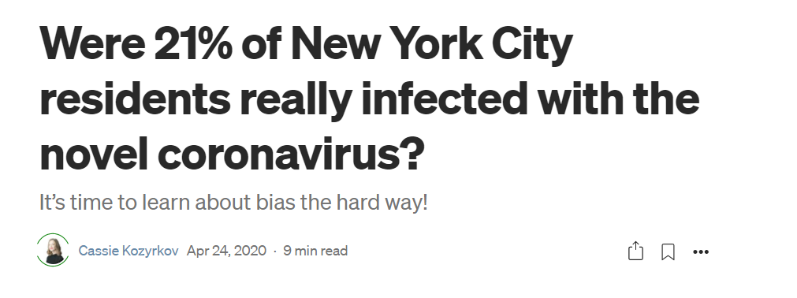
Notes:
Were 21% of New York City residents really infected with the novel coronavirus? | by Cassie Kozyrkov | Towards Data Science
https://towardsdatascience.com/were-21-of-new-york-city-residents-really-infected-with-covid-19-aab6ebefda0

Slide 37
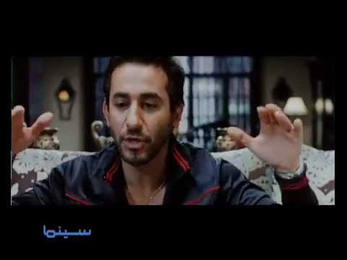

Slide 38
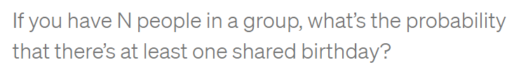
N = 30 friends
Notes:
If you haven’t thought about this one, take a moment to guess. Imagine the group has N=30 people in it. What are the chances two people get their cake on the same day?

Slide 39
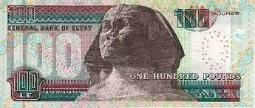
Notes:
Or, if that’s daunting, just answer this: would you prefer to bet me $10 that there are birthday duplicates or $10 that there aren’t?

Slide 40
Basics
“I’m, like, a 1000% sure that, like, they’re going to be late”
Any problem?
Notes:
Yeah
Probability lives between 0 and 1
Or 0 and 100%

Slide 41
How many options?
2 options for a vegetarian dish OR 3 options for a meaty dish

Slide 42
How many options?
2 options for a vegetarian dish OR 3 options for a meaty dish
5
AND one of 2 desserts?

Slide 43
How many options?
2 options for a vegetarian dish OR 3 options for a meaty dish
5
AND one of 2 desserts?
10

Slide 44
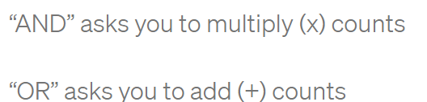
How many options?
2 options for a vegetarian dish OR 3 options for a meaty dish
5
AND one of 2 desserts?
What’s the probability a randomly selected meal is veg-friendly?
10
NUMERATOR = 2 x 2 = 4; DENOMINATOR = 10.
ANSWER = 4/10 = 40%
Notes:
Go look up a proof if you like… or satisfy yourself with a quick example and move along: If I have 2 options for a vegetarian dish OR 3 options for a meaty dish, then how many meal options do I have? 2 + 3 = 5. What if I can choose a main course AND one of 2 desserts? How many different meals am I choosing from? 5 x 2 = 10. Try it out with concrete examples of dishes and write it all out if you don’t believe me.
What’s the probability a randomly selected meal is veg-friendly?
NUMERATOR = 2 x 2 = 4; DENOMINATOR = 10. ANSWER = 4/10 = 40%

Slide 45
Counting basics
probability of NOT getting a 6 on a dice?

Slide 46
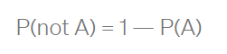
Complement
probability of NOT getting a 6 on a dice?
1–1/6 = 5/6

Slide 47
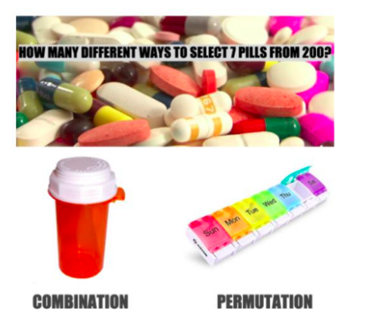
Notes:
The difference between a combination and a permutation is that order matters with permutations but not with combinations. If you think about the image above for a moment, you’ll see why the number of possible options is bigger with permutations than with combinations (if you run the numbers on choosing 7 from 200, you’ll see that the answer on the left is a 13 digit number while on the right it’s a 17 digit number, and if you ogle the formula you’ll see that there’s an extra term in the combination’s denominator that removes the effect of ordering after selection, dumping all the pills into a single container and shaking it). Fun fact: your so-called “combination” bike lock is actually a permutation-with-replacement bike lock. (Technically, a *combination* lock that opens with 1008 should also open with 0810 because order doesn’t matter.)

Slide 48
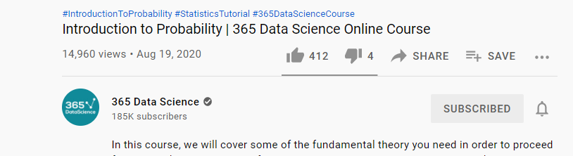
Notes:
Introduction to Probability | 365 Data Science Online Course - YouTube
https://www.youtube.com/watch?v=soZRfdnkUQg&list=PLaFfQroTgZnxtnfht3BzBHVfxodX9AR9F&index=15

Slide 49
approaches to probability
Counting
Frequency-based
Notes:
Event-based (involves enumerating events and counting them)
Frequency-based (involves distributions symbolizing how things would shake out if we observed our phenomenon in infinite parallel universes)
Subjective (involves distributions symbolizing human belief in what’s likely, ideally as expressed in terms of bets… since putting your money where your mouth is reduces your tendency to spew nonsense)

Slide 50
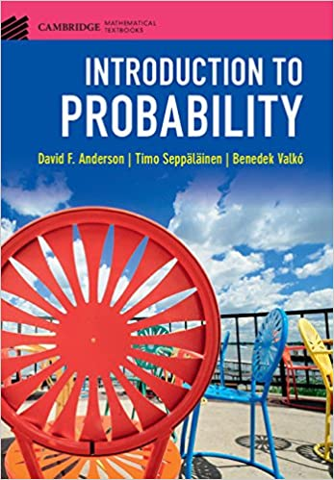
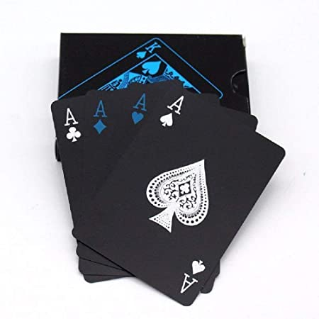

counting
Notes:
The early chapters tend to start with the event-based approach to probability. That’s because it’s an easy playground to get some basics across and most humans probably (heh) already have an intuition for it. Examples: What are the chances your fair coin comes up tails? 1/2. What are the chances you roll a 6 on a six-sided die? 1/6. What’s happening here?

Slide 51
Counting stuff
How many different ways can I select 10 committee members from 100 candidates?”
OR
“How many different options can I choose from when setting a 4-digit PIN?”
Notes:
To work with event-based probability, you need to be able to enumerate events and count them. That’s why your textbook probably drags you through combinatorics till you’re thoroughly sick of it.

Slide 52
وفجأة ....
Where are the counting?
where are combinations?
where are permutations?

Slide 53
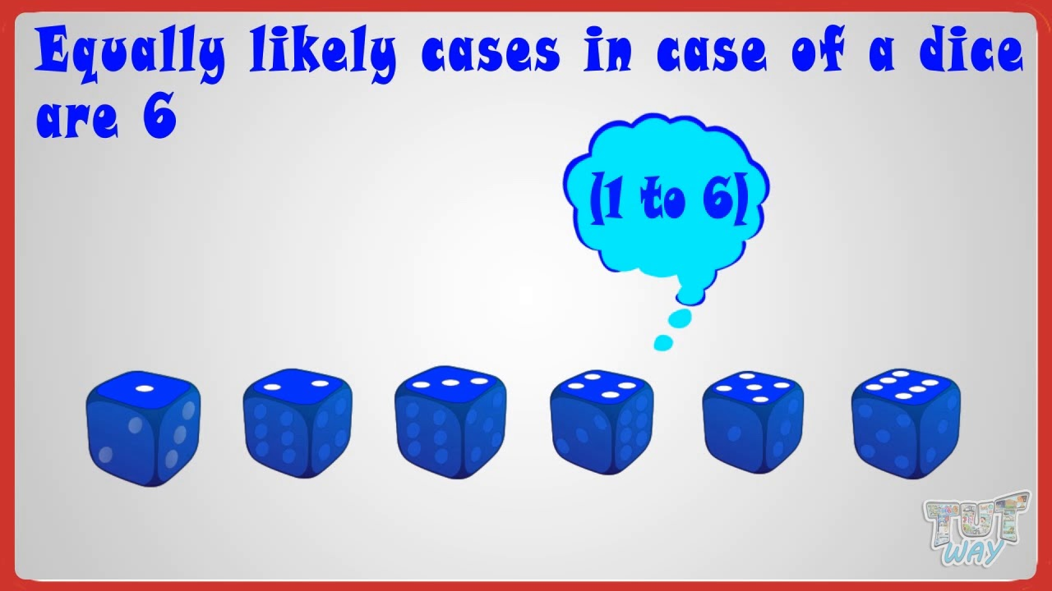
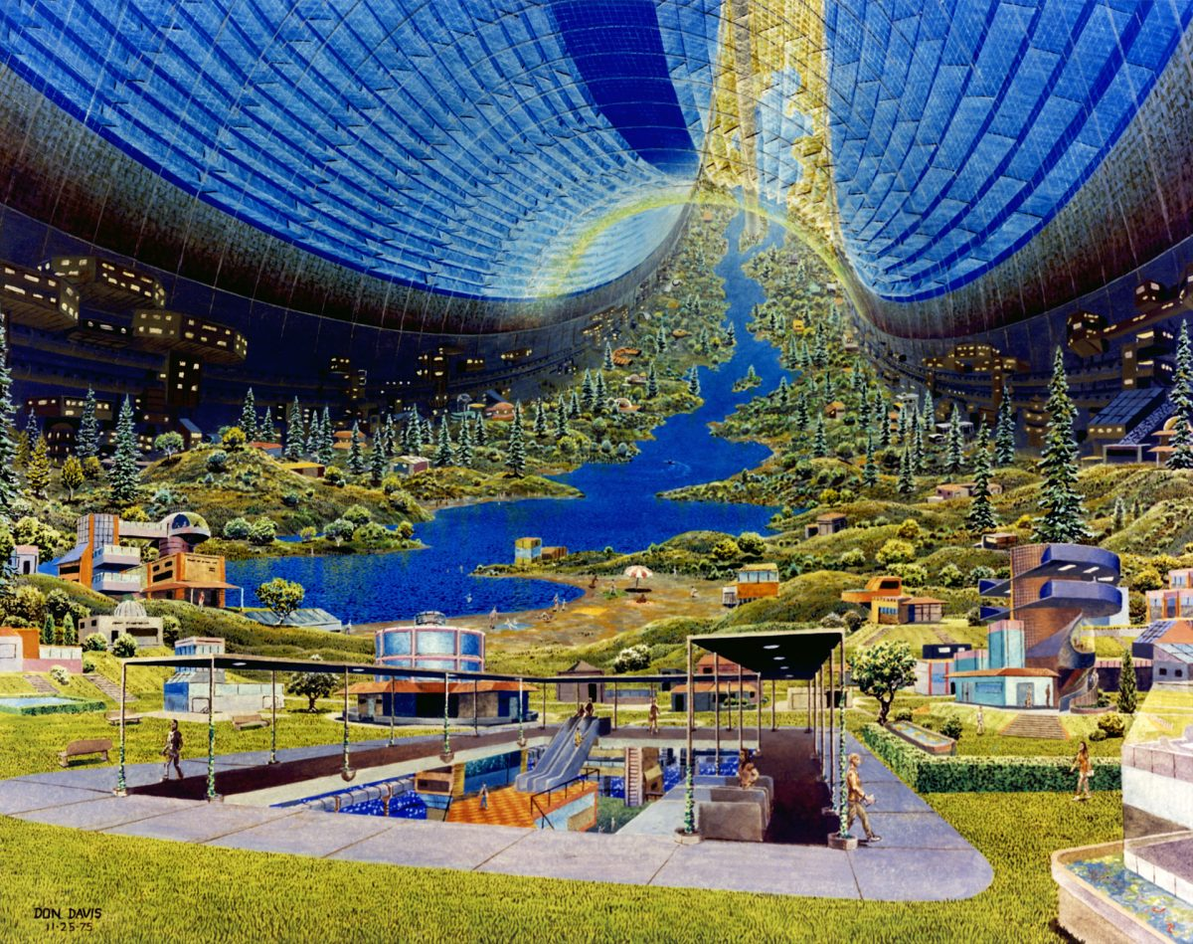
counting
Notes:
In the event-based world, all building block events are equally probable so as to lend themselves to basic arithmetic unmolested by layers of messy modifiers. It’s a world where all the coins are fair, all the dice are balanced, all the cards are unscuffed, and all the birthdays are equally likely.

Slide 54
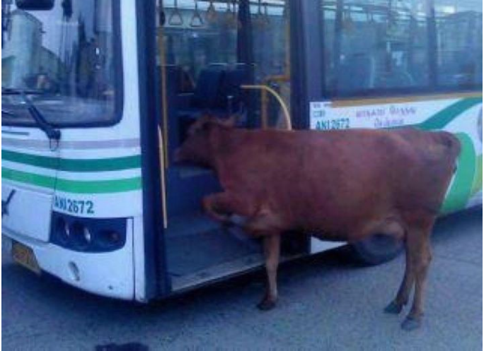
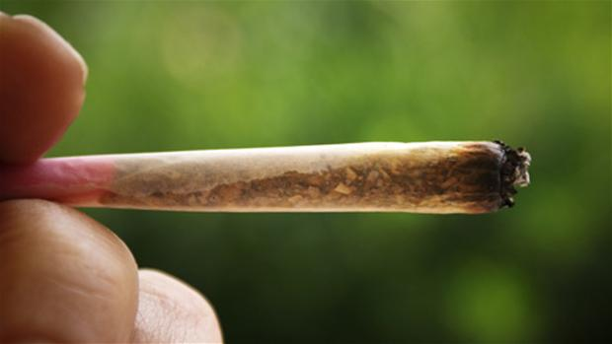
Real life
“What’s the probability you need to wait
more than 10 minutes for the bus?”
Notes:
Consider this question: “What’s the probability you need to wait more than 10 minutes for the bus?” This is going to be tricky to count (in nanoseconds?) and a pain because counting events means you can’t work with time as a continuous thing. It gets worse if you have a bus driver who has some probability of stopping for a smoke break that’s dependent on how late the bus is already. How are you going to enumerate that? You’re not. Maybe counting events isn’t your friend here…

Slide 55
Real life
“What’s the probability you need to wait
more than 10 minutes for the bus?”
Is counting possible?
Notes:
Consider this question: “What’s the probability you need to wait more than 10 minutes for the bus?” This is going to be tricky to count (in nanoseconds?) and a pain because counting events means you can’t work with time as a continuous thing. It gets worse if you have a bus driver who has some probability of stopping for a smoke break that’s dependent on how late the bus is already. How are you going to enumerate that? You’re not. Maybe counting events isn’t your friend here…

Slide 56
approaches to probability
Counting
Frequency-based
Notes:
Event-based (involves enumerating events and counting them)
Frequency-based (involves distributions symbolizing how things would shake out if we observed our phenomenon in infinite parallel universes)
Subjective (involves distributions symbolizing human belief in what’s likely, ideally as expressed in terms of bets… since putting your money where your mouth is reduces your tendency to spew nonsense)

Slide 57
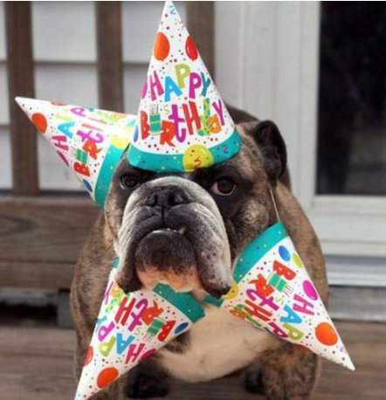
Counting vs distribution?

Slide 58
Counting !!
What’s the assumption?
Notes:
if we assume all 366 birthdays are equally likely*, we can stick with counting. Whew!

Slide 59
Counting !!
What’s the assumption?
all 366 birthdays are equally likely
Any objections?

Slide 60
assumptions
“All solutions are wrong, but whichever one fits the assumptions you’re willing to live with might be useful to you.”

Slide 61
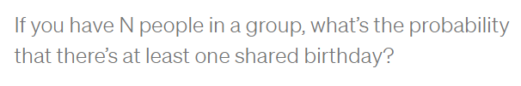
Back to problem!

Slide 62
Birthday DENOMINATOR
How many birthday options do we have for one person?
How many birthday options do we have for N=30 people?

Slide 63
Birthday DENOMINATOR
How many birthday options do we have for one person? 366
How many birthday options do we have for N=30 people?
AND vs OR ?

Slide 64
Birthday DENOMINATOR
How many birthday options do we have for one person? 366
How many birthday options do we have for N=30 people?
AND vs OR ?
366 ➔ 1ST AND 366 ➔ 2ND AND 366 ➔ 3RD … AND 366 ➔ Nth person.

Slide 65
Birthday DENOMINATOR
How many birthday options do we have for one person? 366
How many birthday options do we have for N=30 people?
AND vs OR ?
366 ➔ 1ST AND 366 ➔ 2ND AND 366 ➔ 3RD … AND 366 ➔ Nth person.
366 ^ N

Slide 66
Birthday NUMERATOR
Any idea?

Slide 67
Birthday NUMERATOR
1st ➔ 1 Jan OR
2nd ➔ 1 Jan
OR OR
1st ➔ 9 Feb
2nd ➔ 9 Feb

Slide 68
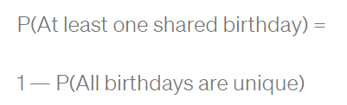
THE TRICK!
Notes:
Instead of counting all the ways we can have people sharing birthdays, the trick is to rephrase the problem and count a much simpler thing: the opposite!
So what we need to find is the answer to this: “What’s the probability that there’s NOT any birthday sharing in the crowd?” In other words, what’s the probability all birthdays are unique?

Slide 69
NUMERATOR
Options available
1st ➔ 366
2nd ➔ ?

Slide 70
NUMERATOR
Options available
1st ➔ 366
2nd ➔ 365
3rd ➔ 364
AND vs OR
Notes:
The first person has 366 options for a birthday (greedy pig) AND the second person has only 365 because we force them to have a different birthday. If person 1 is born on Oct 8 and we’re forcing our room to have N unique birthdays in it, we turn all Oct 8 birthday folk away at the door. Each applicant for the room has fewer options by one.
AND
So it’s 366 options for person 1 AND 365 for person 2 AND 364 for person 3 … AND (367— N) for person N.

Slide 71
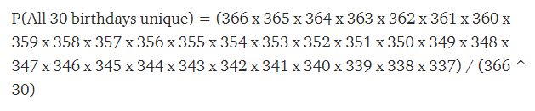
What we want?
= 0.3

Slide 72
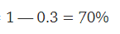
What we want!
= 0.3

Slide 73
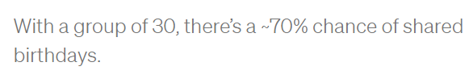
conclusion

Slide 74
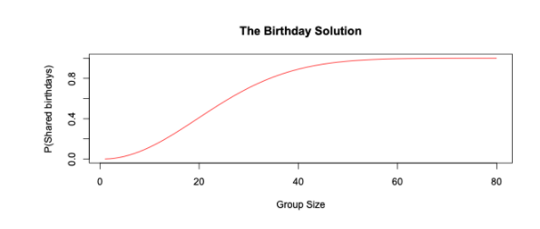
Different N
Notes:
If you’re curious to know the actual numbers (50% happens at N = 23, 99% at N = 55)

Slide 75
IS THIS THE BEST SOLUTION?
Is counting applicable here?
What’s the assumption again?
Notes:
Why is counting such a big deal early on in your textbook and then suddenly it disappears, leaving everyone disgruntled? Turns out that it’s mostly a means to an end, since the assumption that all elementary events are equally likely is too amateurish for most pros to stomach… even for birthdays.

Slide 76
IS THIS THE BEST SOLUTION?
Is counting applicable here?
What’s the assumption again?
all 366 birthdays are equally likely
Is it valid?
Notes:
Why is counting such a big deal early on in your textbook and then suddenly it disappears, leaving everyone disgruntled? Turns out that it’s mostly a means to an end, since the assumption that all elementary events are equally likely is too amateurish for most pros to stomach… even for birthdays.

Slide 77
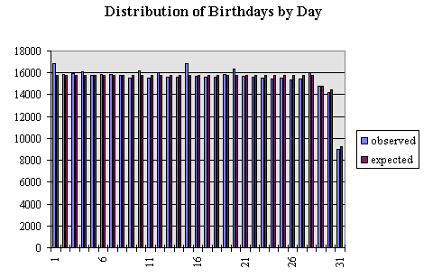
Life insurance data (480,040)
By day
Notes:
An Analysis of the Distribution of Birthdays in a Calendar Year
https://www.panix.com/~murphy/bday.html
it becomes relevant that due to the way hospitals work, where C-sections and induced labor are not generally scheduled on the weekend, more children are born on Mondays and Tuesdays than on weekends.

Slide 78
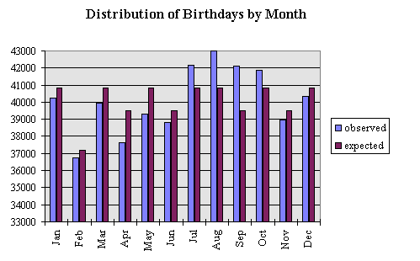
By month
So what?
Notes:
The months July - October show higher than expected births and March - May show the most significant decline in births.

Slide 79
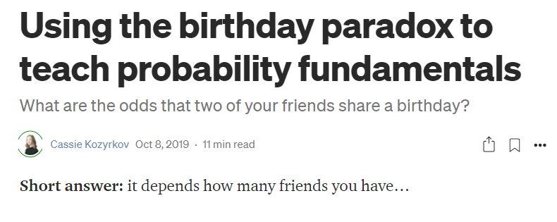
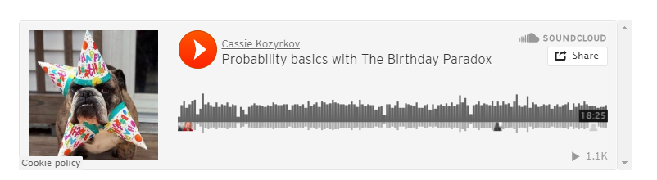
Notes:
Using the birthday paradox to teach probability fundamentals | by Cassie Kozyrkov | Towards Data Science
https://towardsdatascience.com/using-the-birthday-paradox-to-teach-probability-fundamentals-c08bbcb351d1

Slide 80
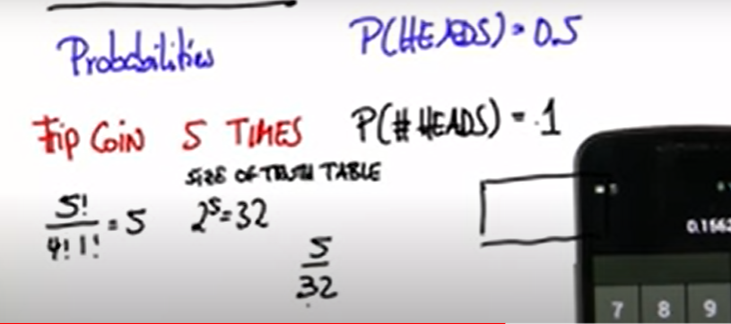
End of counting
Notes:
Guess here u need distribution to account for the fact that they are not equiprobable
U need different values for p ,since p != p

Slide 81
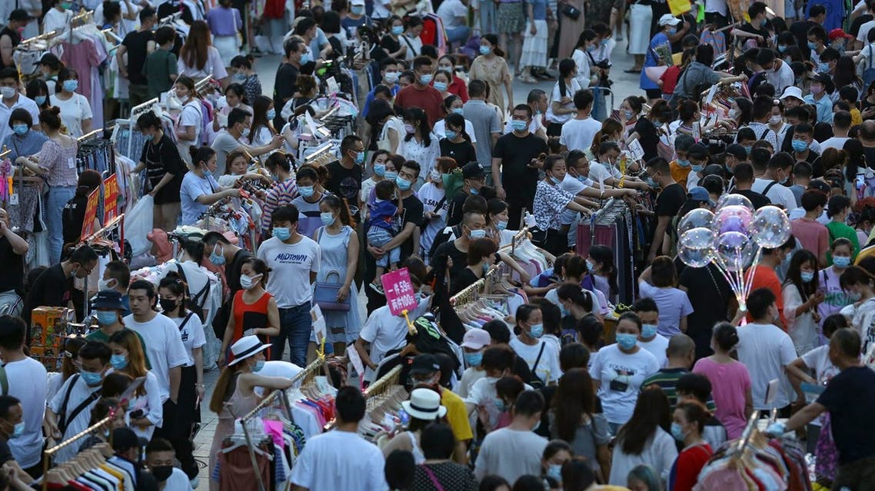
Welcome to distribution

Slide 82
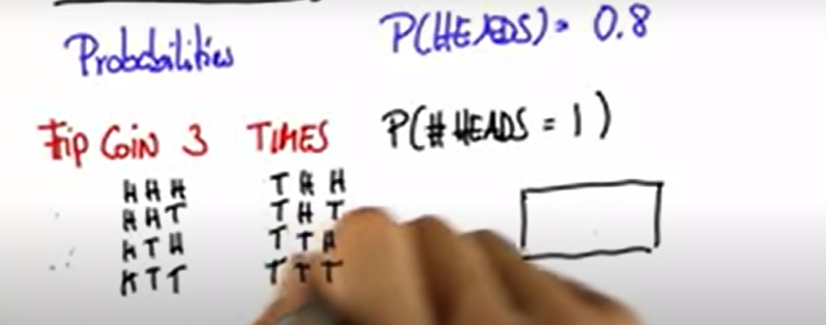
How to solve with combinatorics

Slide 83
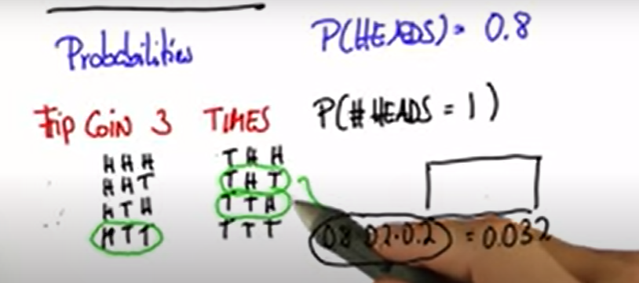
Truth table?
Notes:
U need to use the truth table to calculate the probability
But this is not practical

Slide 84
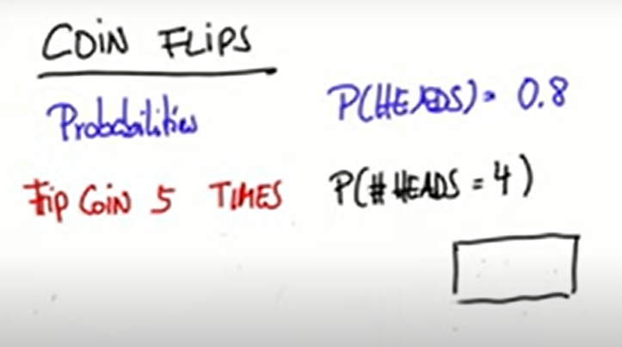
Welcome to distributions

Slide 85
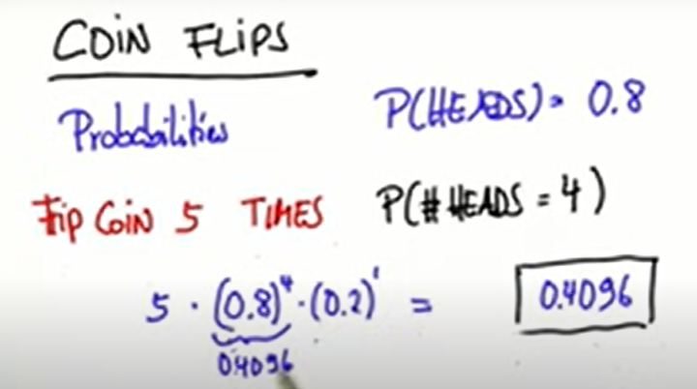
Binomial distribution

Slide 86
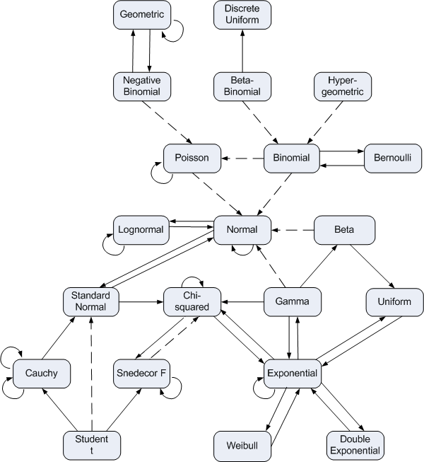

What’s a probability distribution?
pdf
pmf
Notes:
Normal
Binomial
Exponential
Gamma

Slide 87
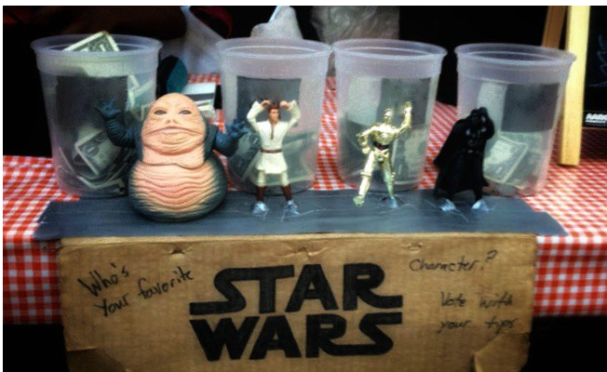
Distribution
Notes:
Which is more popular?
U add money to the bucket
The higher the bucket, the most popular AKA probable

Slide 88
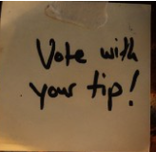
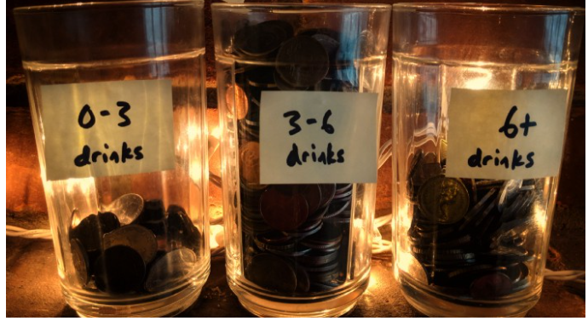
Drinks till vomit
Which chart type?
Notes:
Histogram
Histograms are one way (among many) of summarizing and displaying our sample data. Their blocks are taller for more popular values of the data.

Slide 89
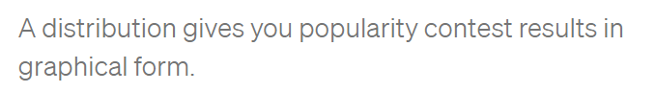
Distribution
Notes:
A distribution is a way to express the probabilities of the entire set of values that X can take.

Slide 90
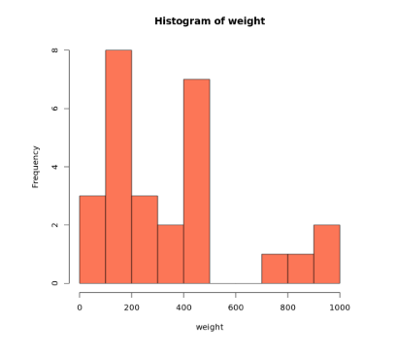
What can we deduce?
How is this related to distribution?
Probability mass
function
Notes:
Now we can clearly see that the two most common categories are 100–200 and 400–500

Slide 91

Welcome to distribution
Notes:
Horizontal axis: population data values. Vertical axis: relative popularity.
As I’ve explained in detail here, a distribution is essentially an imaginary idealized bar chart (for discrete R.V.s) or histogram (for continuous R.V.s).* In other words, the distribution is taller for more likely values of X. The distribution for a fair die has equal height for all outcomes (“discrete uniform”); not so for a weighted die.
Here is the “understanding data” article

Slide 92

More info?
Notes:
Understanding data. Musings on information, memory… | by Cassie Kozyrkov | Towards Data Science
https://towardsdatascience.com/what-is-data-8f94ae3a56b4

Slide 93

Theme

Slide 94


Slide 95


Slide 96


Slide 97

Name of graph?
Describe the graph
in plain terms
Notes:
Histogram

Slide 98

Pick at random?
Notes:
Most probablt Between 5 and 6

Slide 99
Smaller bin size?
Notes:
Between 5 and 6

Slide 100

More precise?
Describe data
Notes:
Majority are between 5.25 nad 5.75

Slide 101

Even smaller?
Notes:
More accurate and more precise

Slide 102

approximation
Why is that useful?
Notes:
We can use a curve to approximate the histogram

Slide 103

No benefit yet
Any thing useful?
Notes:
Low prob at tails
And high probability at the peak

Slide 104


solution
Notes:
No bins can accommodate this

Slide 105

Notes:
More precise calculate using calculus or a computer

Slide 106

Notes:
StatQuest: What is a statistical distribution? - YouTube
https://www.youtube.com/watch?v=oI3hZJqXJuc

Slide 107
How to choose?
Why to choose?
Notes:
Normal
Binomial
Exponential
Gamma
Pdf
Pmf

Slide 108

Pause a minute

Slide 109

Pause a minute

Slide 110
Is the study worthless?
As good as the assumptions
Notes:
Does this mean that the study is worthless? No, but it’s only as good as the assumptions you’ll make about it. Since there’s very little that we know for sure from its data, the only way to make inferences beyond the facts is to bridge the gap with assumptions. That’s all statistics is. Assumptions, not magic.
Unfortunately, we’re not all equally qualified to make good assumptions that lead to useful conclusions. For example, while I am a statistician with plenty of real-world data collection experience, I’m not an expert in antibody tests, so you shouldn’t trust me to make wise assumptions about their accuracy. Excellent! I don’t trust me either, so I’ll end up learning nothing about the virus exposure rate of NYC. The study is worthless in my hands.

Slide 111
How to choose?
Why to choose?
Notes:
Normal
Binomial
Exponential
Gamma
Pdf
Pmf

Slide 112

لولو من أبولو

Slide 113

It differs
Notes:
List of Probability Distributions - Stat Mania English
http://en.statmania.info/2015/08/list-of-probability-distribution.html

Slide 114
Choosing Your Distribution
1- assume a distribution
2- other solutions (to be continued …)
Notes:
They either (1) estimate empirical distributions from their data — using, you guessed it, histograms! — or they (2) make theoretical assumptions about which member of a popular distribution catalog looks most similar to how they believe their data source behaves.
3) Kernel density without assumptions
MLE or method of moment
Or kernel density estimation
Or use bootstrap
I need to read Tom’s lectures

Slide 115

Which distribution?

Slide 116

Popular distributions
Notes:
On the plus side, named distributions come with neat PDFs and a bunch of calculations pre-done for you.
On the minus side, your application might not fit anything in a catalog. Thanks for the empirical option.
For the empirical, I think it may be hard to generalize.
Many items, ex. Bin size can make results unpredictable
Check the medium article

Slide 117



Why do I need a distribution?
Notes:
Imagine u r in an algebra exam.
U have a formula sheet
W see the questions and u want to answer ..
What to do?
Check the questions and see which one of them fits in ur sheet
Then answer
Or u can invent or derive a formula
Which needs time, validation, etc..

Slide 118

Why wait?
Notes:
If we have our data, and we have assumed a popular distribution. Why not start plotting?
Let’s be honest — the insights aren’t exactly leaping off the page. That’s why we tend to prefer asking questions about specific parameters of interest to us. In statistics, parameters summarize populations or distributions. For example, if you’re asking whether the distribution peaks at zero, you’re asking about the location of its mode (a parameter). If you’re asking how fat the distribution is, you’re asking about its variance (another parameter). In a moment, I’ll take you on a tour of a few of my favorite parameters.

Slide 119

Without parameters ☺
Notes:
If you look at the function above, you’ll notice that there are some Greek letters in there: μ and 𝜎.*** These are special parameters for this distribution; until we replace them with numbers, we’re not ready to plot anything. Without them, all we can do is get a vague sense of the abstract shape of the distribution, like so:

Slide 120
لولو من أبولو
Notes:
Aren’t all of these are normal distributions?

Slide 121

Normal distribution
http://shiny.calpoly.sh/Prob_View/
Notes:
There’s plenty more Greek to enjoy, since other distributions use other characters for their special quantities.

Slide 122
Pause a minute

Slide 123

More info?
This is part 1
Notes:
Getting to know probability distributions | by Cassie Kozyrkov | Mar, 2021 | Towards Data Science
https://towardsdatascience.com/getting-to-know-probability-distributions-cc1dd1e2f22b

Slide 124
Theme

Slide 125

Conditional probability

Slide 126


Slide 127


Slide 128


Slide 129


Slide 130

Notes:
Can’t answer!!!
We need the prevalence
True for positive predictive value

Slide 131
How common is the disease?
Prevalence
1%

Slide 132

Notes:
Are they of equal importance to me?
Which one u thing is the false positive ?

Slide 133


Is this good?
Notes:
Maybe it’s not bad
Maybe we need this test to exclude, and if we have false positive, we can head to a better test with higher specificity

Slide 134


Slide 135

Notes:
Conditional Probability Explained: Visual Intuition - YouTube
https://www.youtube.com/watch?v=by3_weGwnMg

Slide 136
Quick refreshment

Slide 137



Types of probability
Notes:
if A is an event, then the marginal probability is the probability of that event occurring, P(A). Example: Assuming that we have a pack of traditional playing cards, an example of a marginal probability would be the probability that a card drawn from a pack is red: P(red) = 0.5.
The probability of the intersection of two or more events. If A and B are two events then the joint probability of the two events is written as P(A ∩ B). Example: the probability that a card drawn from a pack is red and has the value 4 is P(red and 4) = 2/52 = 1/26.
Conditional Probability: The conditional probability is the probability that some event(s) occur given that we know other events have already occurred
Example: the probability that a card is a four given that we have drawn a red card is P(4|red) = 2/26 = 1/13. (There are 52 cards in the pack, 26 are red and 26 are black.

Slide 138


Slide 139



The link

Slide 140


What’s the joint probability
The AND
6 and head

Slide 141

Solution
6 and head
Any thing special?
Notes:
(B). We know that event A is tossing a coin and B is rolling a die. So P(A|B) term asks “what is the probability of the coin landing on heads given that I’ve rolled a 6 on the die?” This is where we intuitively understand that the outcome of tossing the coin doesn’t depend on the roll of the die. The events are said to be independent. In this scenario the result of the coin toss would be the same no matter what we rolled on the die. Mathematically we express this as P(A|B) = P(A). Therefore when the events are independent, the joint probability is just the product of the individual marginal probabilities of the events: P(A ∩ B) = P(A) ✕ P(B). So P(coin landing heads and rolling a 6) = P(A=heads, B=6) = 1/2 ✕ 1/6 = 1/12.

Slide 142


Solution
6 and head
Notes:
Notice that I wrote P(A=heads, B=6). The comma between the events is shorthand for joint probability (you will see this written in the literature).

Slide 143

OR Rule
6 OR head
Notes:
find the probability of rolling a 6 or the coin landing on heads.
add the individual probabilities and subtract the intersection.
Mathematically we write this as P(A ∪ B) = P(A) + P(B) - P(A ∩ B).
So let’s change our example above to find the probability of rolling a 6 or the coin landing on heads. This is P(coin landing heads or rolling a 6) = P(A=heads ∪ B=6) = 1/2 + 1/6 - 1/12 = 6/12 + 2/12 - 1/12 = 7/12

Slide 144
Problem
What’s special?
Notes:
There are occasions when we don’t have to subtract the intersection. This happens when the two circles in the Venn diagram don’t overlap. When the circles for two events do not overlap we say that these events are mutually exclusive. This implies that the intersection is zero, written mathematically as P(A ∩ B) = 0. Let’s do an example that covers this case. Suppose we roll a die and we want to know the probability of rolling a 5 or a 6. These events are mutually exclusive because I can’t roll a 5 and a 6. Therefore, their circles in a Venn diagram do not overlap. So the probability of rolling a 5 or a 6 is equal to 1/6 + 1/6 = 2/6 = 1/3 (we haven’t subtracted anything).

Slide 145


Solution
mutually exclusive.
Notes:
There are occasions when we don’t have to subtract the intersection. This happens when the two circles in the Venn diagram don’t overlap. When the circles for two events do not overlap we say that these events are mutually exclusive. This implies that the intersection is zero, written mathematically as P(A ∩ B) = 0. Let’s do an example that covers this case. Suppose we roll a die and we want to know the probability of rolling a 5 or a 6. These events are mutually exclusive because I can’t roll a 5 and a 6. Therefore, their circles in a Venn diagram do not overlap. So the probability of rolling a 5 or a 6 is equal to 1/6 + 1/6 = 2/6 = 1/3 (we haven’t subtracted anything).

Slide 146

Want to learn more?

Slide 147

Notes:
humor - What is your favorite "data analysis" cartoon? - Cross Validated
https://stats.stackexchange.com/questions/423/what-is-your-favorite-data-analysis-cartoon/38295#38295
But if you know that "there is a bomb" (yours) in the plane, which we may call event AA, and you are willing to accept that the "existence of a second bomb" (event BB) is independent of AA, then P(B∣A)=P(B)=1/1000P(B∣A)=P(B)=1/1000. Always condition on what you know. And yeah, I deserve a −1−1 for screwing a good joke

Slide 148

Importance of distribution or conditional probability
Notes:
Greetings new recruits! Welcome to the training camp for gladiators
Be warned! One in three of you does not survive the training
33.3% ... That's not so bad
humor - What is your favorite "data analysis" cartoon? - Cross Validated
https://stats.stackexchange.com/questions/423/what-is-your-favorite-data-analysis-cartoon/38295#38295
As a pointer to why we should think about conditional probabilities (and from then on, to why tools like logistic regression are useful for predicting risk) this is an excellent cartoon.

Slide 149


Slide 150

Heart of bayes theorem?
Notes:
Base Rate Fallacy - Biases & Heuristics | The Decision Lab
https://thedecisionlab.com/biases/base-rate-fallacy/

Slide 151

مدينة السمبلاوين
85% are blue and 15% are green.
Notes:
Example 1 - The cab problem
This classic example of the base rate fallacy is presented in Bar-Hillel’s foundational paper on the topic.¹¹ First, participants are given the following base rate information. There are two cab companies in a city: one is the “Green” company, the other is the “Blue” company. The names of the company refer to the colors of their respective taxis. It is specified that, of all the cabs in the city, 85% are blue and 15% are green.

Slide 152



Hit and run
Notes:
Then, a scenario is described in which a cab, which a witness later identifies as green, was involved in a hit and run one night.

Slide 153

Probability that hit was by green car?
witness can accurately distinguish the colors 80% of the time but confuses them 20% of the time
Notes:
In order to assess the reliability of the witness, the court ordered that their ability to discriminate between blue and green cabs at nighttime be tested. It is shown that the witness can accurately distinguish the colors 80% of the time but confuses them 20% of the time. Participants are then asked to give the likelihood that the cab involved in the hit and run was actually green.

Slide 154
Base rate neglect
85% are blue and 15% are green.
P(witness correct) = 41%.
Notes:
Many people are inclined to respond that the probability that the witness correctly identified a green cab at night is 80%. However, everyone who gives that answer is committing the base rate fallacy. When taking into account the base rate information, which tells us that only 15% of the cabs in the city are green, the actual probability that the witness was correct is 41%. This probability is achieved through inferential statistics calculations, which take into account both the percentage of each color cab in the city and the likelihood that the witness correctly discriminated between the colors at night.

Slide 155

Rule 1
Notes:
This is very common and it is called “base rate neglect”

Slide 156
Breakout room
https://projects.datacamp.com/projects/163

Slide 157

Notes:
What’s the probability that if he left the kitchen and took a look of the balcony that he will come back and kidnap the kids?

Slide 158


Slide 159

Should have this effect

Slide 160

What if the outcome is scary?
Notes:
Sure u can take precautions
But it totally differs if u are taken precautions because something will happen for sure
Or if u know it is still not common ( so u won’t freak out) and u still take the precautions

Slide 161

Notes:
Are people expected to know the probability of a repair’s man being a robber? No

Slide 162

The question is:
Notes:
Did u consider it?
Rationality is not about knowing facts
It’s about knowing which facts are relevant

Slide 163


How to deal with info?
Notes:
Bob is jealous from amy
The likelihood: one time amy didn’t finish a project she was assigned
Bob is complaining about amy not finishing the project

Slide 164


Slide 165

What if not jealous?
Notes:
If he wasn’t jealous, there is still a high probability that he would complain about her

Slide 166

Update rationally

Slide 167

Rule 2

Slide 168


Slide 169

What u think?

Slide 170
New data
A smart friend tells u meditation is useful
What to do?

Slide 171

Update a bit!
It depends
Notes:
Depends on ur prior.. Were u sure that meditation was fake?
Is ur friend related to meditation?
Apart from being smart? Do u trust him?

Slide 172


More and more info?

Slide 173

3 rules

Slide 174

Want more info?
Notes:
A visual guide to Bayesian thinking - YouTube
https://www.youtube.com/watch?v=BrK7X_XlGB8

Slide 175
Heart of bayes’ theorem?
???

Slide 176


Slide 177

Maybe we differ
Notes:
But how we update our beliefs is what really matter

Slide 178

bayes

Slide 179


Slide 180


Slide 181


Slide 182


Slide 183


Slide 184


Slide 185


Slide 186


Slide 187


Slide 188


Slide 189


Slide 190


Slide 191


Slide 192


Slide 193

Any redundancy?

Slide 194


Any redundancy?

Slide 195
Love redundancy ☺
Any redundancy?

Slide 196

More info?
Notes:
Live 2020-05-18!!! Bayes' Theorem - YouTube
https://www.youtube.com/watch?v=ONCOkccpk3w

